Slide 1
Modernizing Applications with Containers and Orchestrators

Slide 2
Module 7 – Monitoring and Troubleshooting Containers

Slide 4
Objectives
Useful docker and kubectl commands for troubleshooting containers
Azure Monitor for containers
3rd Party Azure Partner Solutions
Notes:
In this module we are going to discuss
Some troubleshooting techniques to understand why docker container fail
How we can monitor containers using Azure Monitor for containers
We are going to list some 3rd party tools that are also available when running Azure containers in Azure.

Slide 5
docker commands for troubleshooting
docker logs
docker stats
docker attach
docker top
docker events
docker inspect
docker history

Slide 6
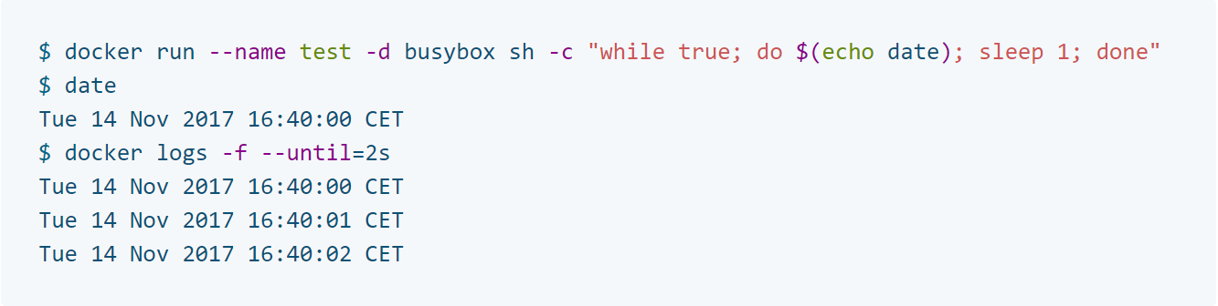
docker logs
Retrieves container logs present at the time of execution
*Retrieve logs until a specific point in time
docker cp <container_id>:/path/to/useful/file /local-path
Notes:
Start Here: This’ll give you the full STDOUT and STDERR from the command that was run initially in your container
Many programs log stuff to stdout, especially when things go south
Anything that gets written to stdout for the process that is pid 1 inside the container will get captured to a history file on the host, where it can be viewed with the logs command
This history is available even after the container exits, as long as its file system is still present on disk (until it is removed with docker rm)
The data is stored in a json file buried under /var/lib/docker
The log command takes options that allow you to follow this file, basically tail -f, as well as choose how many lines the command returns (tail -n). By default the command returns all lines.
docker cp <container_id>:/path/to/useful/file /local-path Often just getting hold of more log files is enough to sort you out. If you already know what you want, docker cp has your back: copy any file from any container back out onto your local machine, so you can examine it in depth (especially useful analyzing heap dumps).
Links for additional learning:
https://docs.docker.com/engine/reference/commandline/logs/

Slide 7
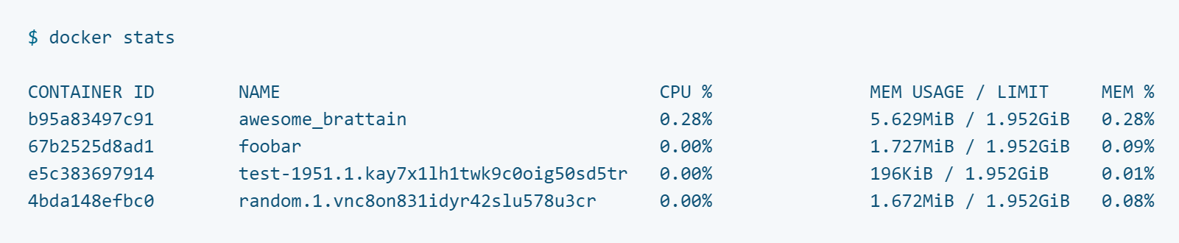
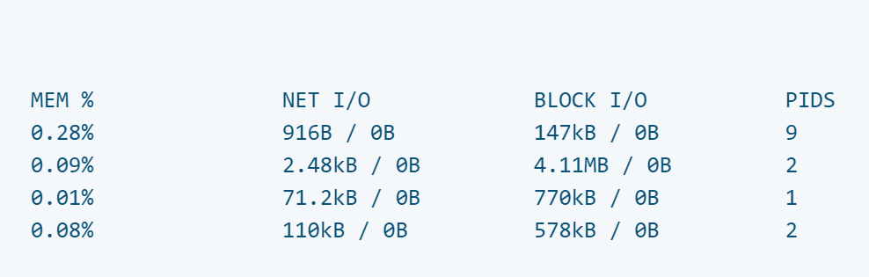
docker stats
A live stream of resource usage, so you can see just how much memory you’ve leaked so far
Notes:
If you just need to keep an eye on the metrics of your container to work out what’s gone wrong, docker stats can help: it’ll give you a live stream of resource usage, so you can see just how much memory you’ve leaked so far

Slide 8
Stream stdout with docker attach
Attach your terminal’s standard input, output, and error (or any combination of the three) to a running container using the container’s ID or name.
Notes:
Attach to attach the standard input/output and error of a container to your terminal
Note: The attach command will display the output of the ENTRYPOINT/CMD process. This can appear as if the attach command is hung when in fact the process may simply not be interacting with the terminal at that time.
KEEP IN MIND:
Can use docker exec to run commands in the container or to start an interactives session to dig around further
Links for additional learning:
https://docs.docker.com/engine/reference/commandline/attach/

Slide 9
Get process stats with docker top
Displays all running processes of a container including information about process name, ID, CPU usage, and private memory
Notes:
Top command to display all running processes in a container (Process Id, name, CPU/Memory consumption)

Slide 10
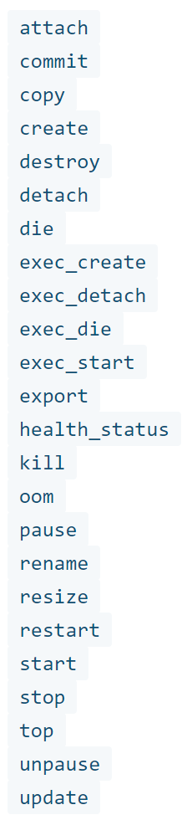
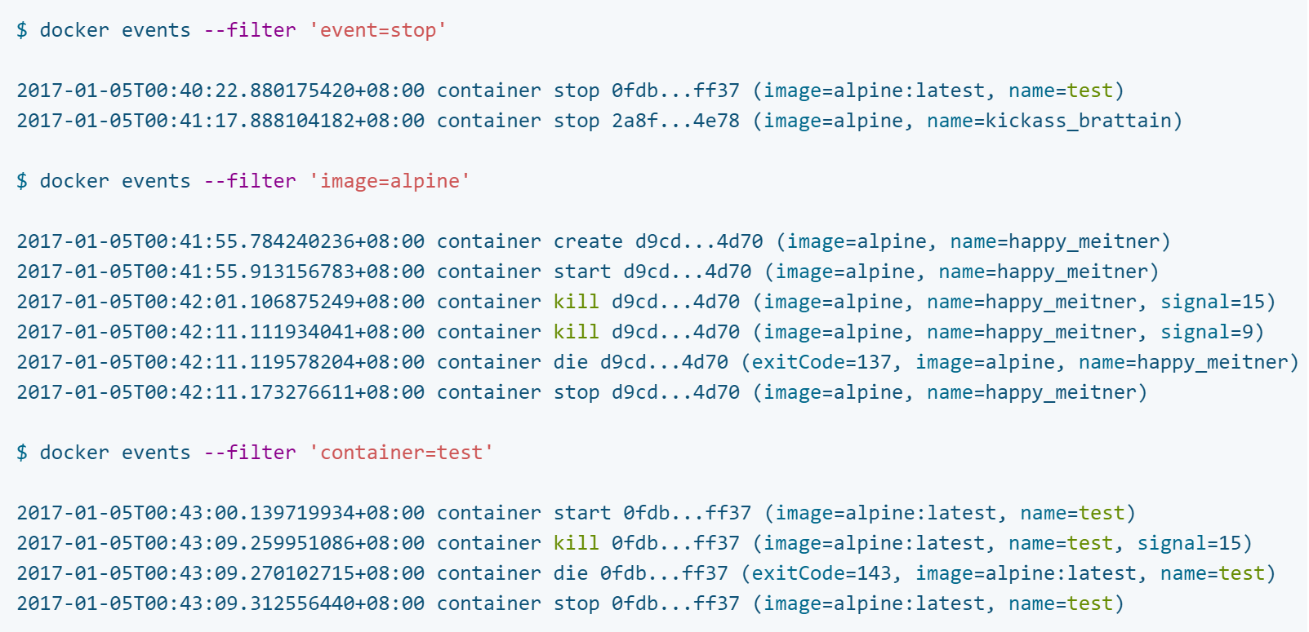
docker events
Docker containers will report the following real-time events: create, destroy, die, export, kill, oom, pause, restart, start, stop, and unpause
Notes:
Events gives you some lifecycle related information
Can be used with Images, Volumes, Networks, etc. as well
Additional links for learning:
https://docs.docker.com/engine/reference/commandline/events/#parent-command

Slide 11
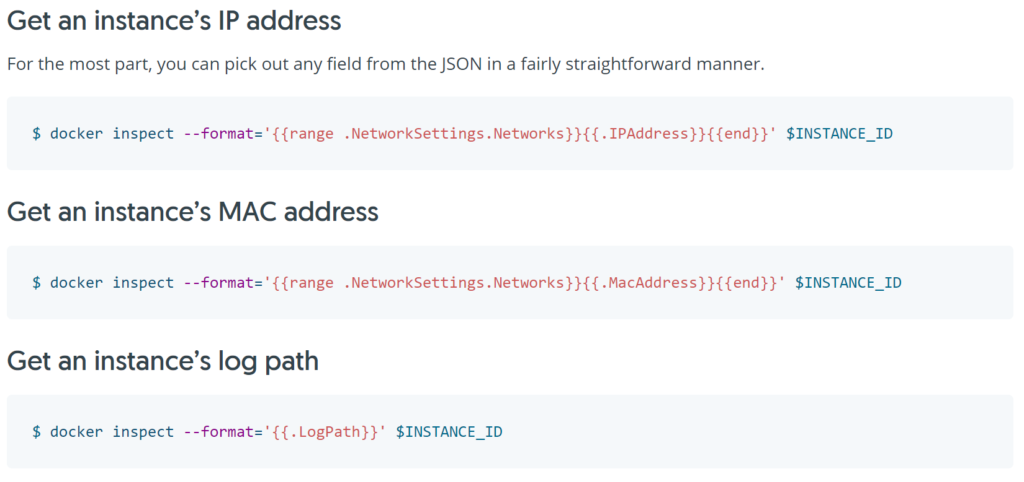
View container details with docker inspect
Return low-level information on Docker objects
By default, docker inspect will render results in a JSON format which can be parsed inline or saved on file
Notes:
Useful for retrieving details for further troubleshooting.
Types of output you can use:
Current state of the container. (In the “State” property.)
Path to the log history file. (In the “LogPath” field.)
Values of set environment vars. (In the “Config.Env” field.)
Mapped ports. (In the “NetworkSettings.Ports” field.)
Links for additional learning
https://docs.docker.com/engine/reference/commandline/inspect/

Slide 12
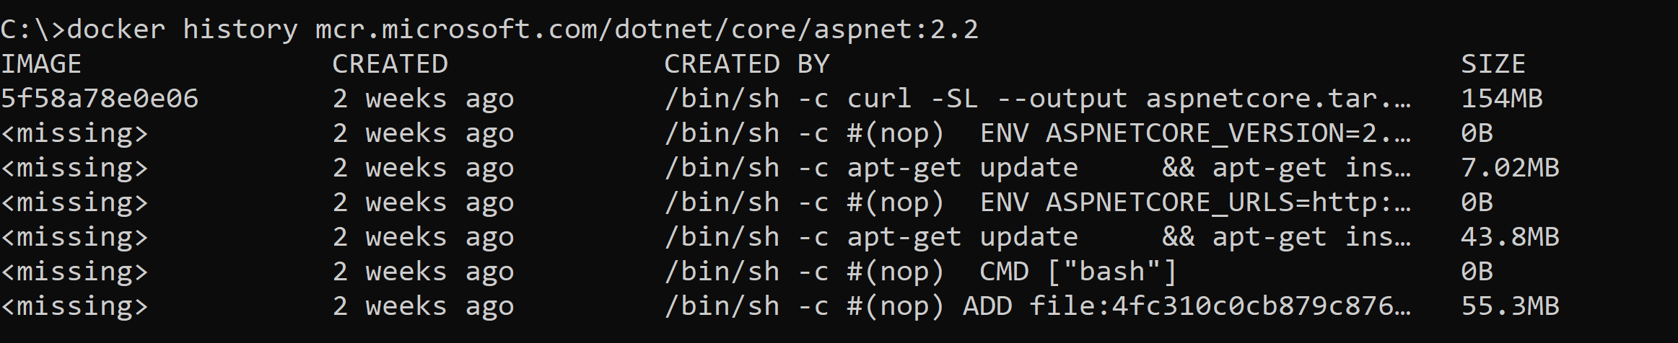
docker history
Provides full history of an image
Useful for retrieving full footprint of each layer and subsequent sizes etc.
Notes:
History To answer questions like: how did we go from X GB size to Y GB size
https://docs.docker.com/engine/userguide/storagedriver/imagesandcontainers/#sharing-promotes-smaller-images

Slide 13
Can’t start your container at all?
Save the current state of the shut-down container as a new image
Start that with a different command to avoid your existing failures
docker commit <container_id> my-broken-container &&
docker run -it my-broken-container /bin/bash
Notes:
docker commit <container_id> my-broken-container && docker run -it my-broken-container /bin/bash
Can’t start your container at all? If you’ve got a initial command or entrypoint that immediately crashes, Docker will immediately shut it back down for you.
This can make your container unstartable, so you can’t shell in any more, which really gets in the way.
Fortunately, there’s a workaround: save the current state of the shut-down container as a new image, and start that with a different command to avoid your existing failures.
Have a failing entrypoint instead? There’s an entrypoint override command-line flag too.
Troubleshoot networking: https://success.docker.com/article/troubleshooting-container-networking

Slide 14
kubectl troubleshooting commands
kubectl logs my-pod
kubectl describe pods my-pod
kubectl exec my-pod -- <your command>
Will run the command inside the container
Ex. kubectl exec -it my-pod -- Powershell
https://kubernetes.io/docs/tasks/debug-application-cluster/debug-pod-replication-controller/
Notes:
Beyond Docker troubleshooting commands -> orchestration specific commands.
K8 logs : will show logs printed by the container when it started in the pod
k8 describe: will show pod details: IP, ports, pod state, last successful run, …
K8 exec: run a command within the pod: example: kubectl exec cassandra -- cat /var/log/cassandra/system.log => to display a particular file deployed in the container.
More information at the link on the slide.
https://kubernetes.io/docs/tasks/debug-application-cluster/debug-pod-replication-controller/

Slide 15
Common container monitoring pain points…
“I am having an issue
with my application but cannot see any issues?“
Cluster health
Guidance for troubleshooting
Drill down experience with filters
“Many tools have nice graphs, but don’t
help me understand where to go to troubleshoot”
“I want to monitor my cluster but also have filters to focus on my workloads.”
Usability and
Control
Lower
maintenance
cost
Native monitoring experience
“I don’t want my devs to touch kubectl commands. It is another tool with additional learning.”
“I know OSS monitoring products, but I want to focus on my products rather than maintaining monitoring tools.”
“If I am using Azure already, can Microsoft provide monitoring tools for me?”

Slide 16
Things to monitor
Cluster health: general status, number of nodes, pods
Node health: available compute resources, status,…
App health: the application is working properly?

Slide 17
Traditional Monitoring
App
App
APM monitor
identify and pinpoint bottlenecks or errors
thru APM
OS
OS
Infrastructure monitor
CPU, memory,
network, storage
perf and logs
Hypervisor
Notes:
Application performance management

Slide 18
Gap in Stack with Containers
App
App
App
App
APM monitor
identify and pinpoint bottlenecks or errors
thru APM
Containers
Gap
OS
OS
Infrastructure monitor
CPU, memory, network, storage
perf and logs
Hypervisor
Notes:
Enter the need for Azure Monitor for Containers

Slide 19

Azure Monitor for Containers overview
Visualization
Visualize overall health and performance from clusters to containers with drill downs and filters
Observability
Insights
Provide insights with multi-cluster health roll up view
Azure Pipelines
Kubernetes control
Azure Monitor for containers
Monitor & Analyze
Monitor and analyze Kubernetes and container deployment performance, events, health, and logs
NEW!
Response
Native alerting with integration to issue managements and ITSM tools
ACI burst from AKS
Observability
Observe live container logs on container deployment status
Notes:
Resources:
https://docs.microsoft.com/en-us/azure/azure-monitor/insights/container-insights-overview
Details:
After you enable monitoring from Kubernetes clusters, these metrics and logs are automatically collected for you through a containerized version of the Log Analytics agent for Linux and stored in your Log Analytics workspace.
Why use?
Identify AKS containers that are running on the node and their average processor and memory utilization. This knowledge can help you identify resource bottlenecks.
Identify processor and memory utilization of container groups and their containers hosted in Azure Container Instances. Identify where the container resides in a controller or a pod. This knowledge can help you view the controller's or pod's overall performance.
Review the resource utilization of workloads running on the host that are unrelated to the standard processes that support the pod.
Understand the behavior of the cluster under average and heaviest loads. This knowledge can help you identify capacity needs and determine the maximum load that the cluster can sustain.

Slide 20
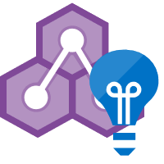
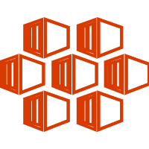
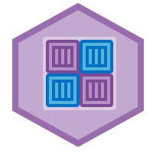
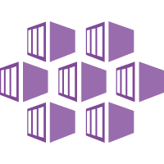


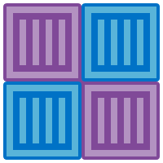
Single-pane view
Azure Monitor for Containers
Controller
Node
Container
Cluster
NEW: Multi-cluster
pod
pod
pod
Notes:
You can access Azure Monitor for containers two ways, from Azure Monitor or directly from the selected AKS cluster.
From Azure Monitor you have a global perspective of all the containers deployed, which are monitored and which are not, allowing you to search and filter across your subscriptions and resource groups, and then drill into Azure Monitor for containers from the selected container.
Otherwise, you can simply access the feature directly from a selected AKS container from the AKS page.

Slide 21
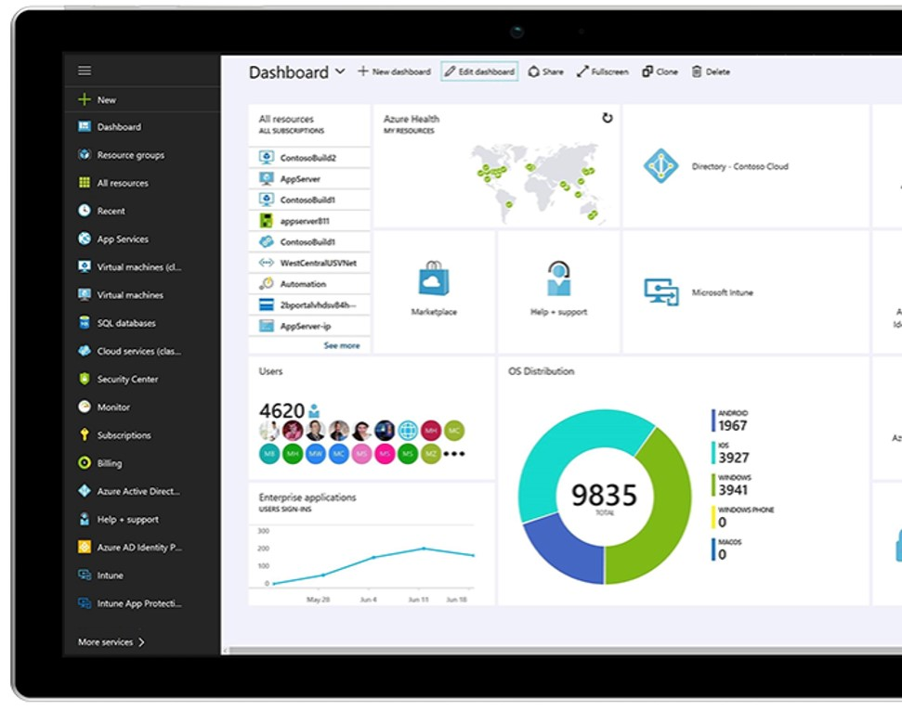
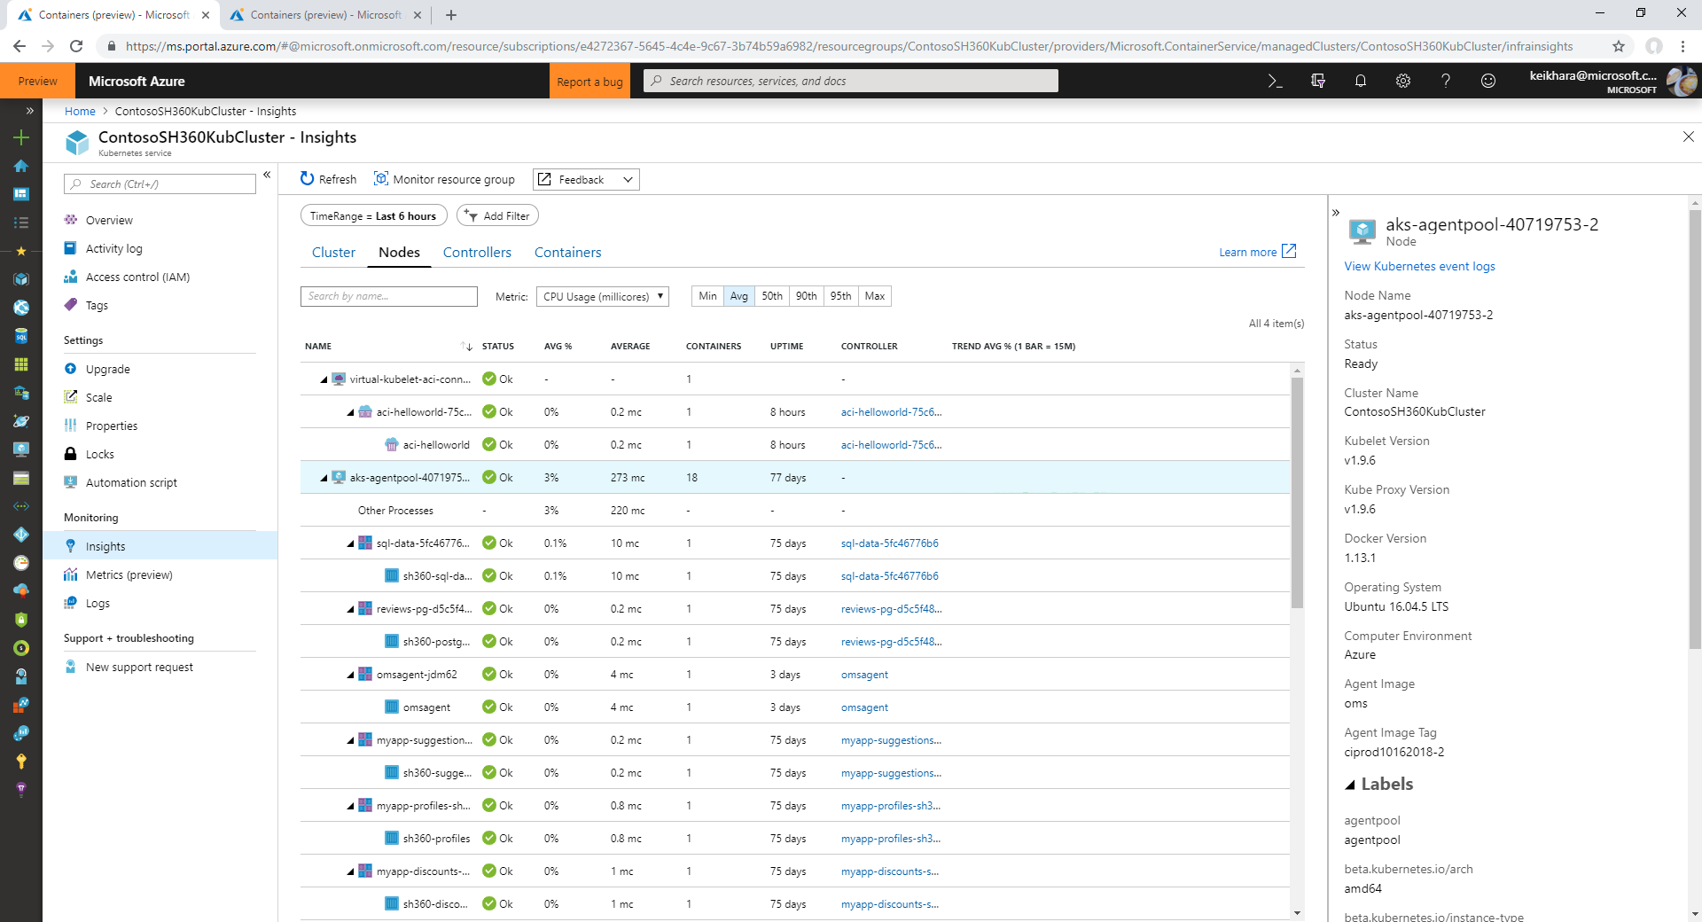
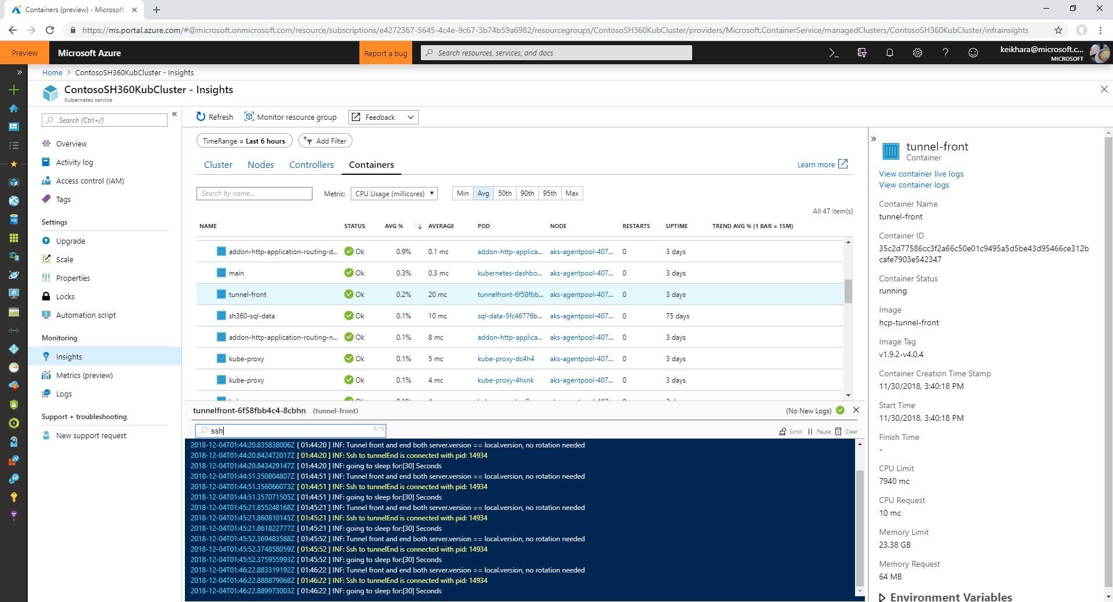
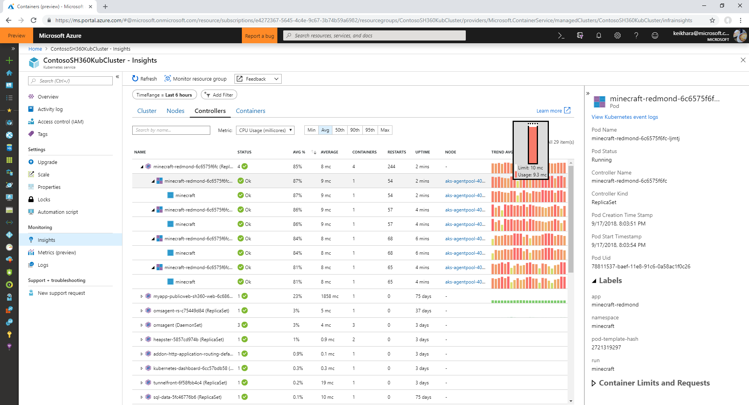
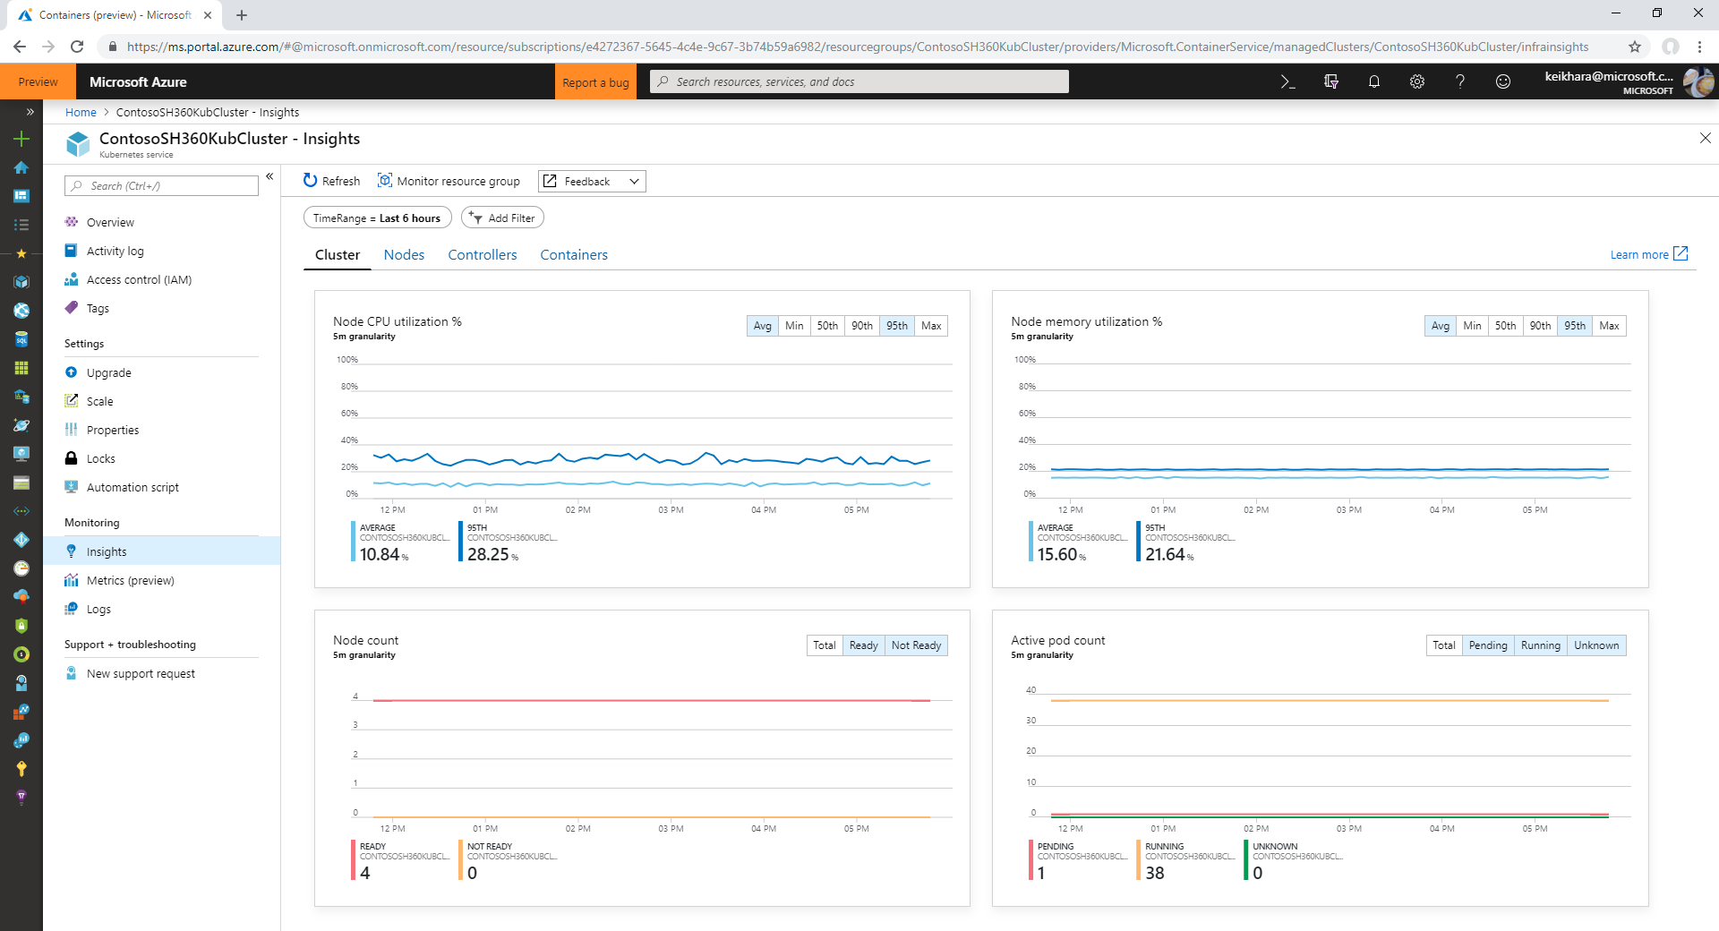
Azure Monitor for Containers UI
1
2
3
4
Get detailed insights about your workloads with Azure Monitor
See graphical insights about clusters
Filter for details about nodes, controllers, and containers
Pull events and logs for detailed activity analysis

Slide 22
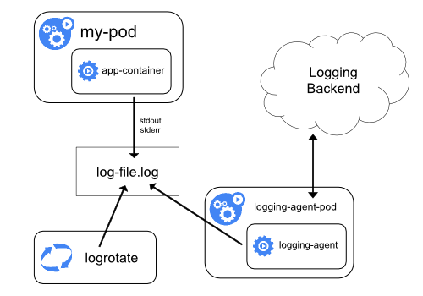
Logging architecture – node-level logging agent
Most common and encouraged approach for Kubernetes cluster
One agent per node (Daemon Set)
No changes to the applications running on the node
Only works for applications with standard output and standard error
Notes:
This is how the OMS agent is deployed, as a daemon set
The logging agent is a dedicated tool that exposes logs or pushes logs to a backend. Commonly, the logging agent is a container that has access to a directory with log files from all of the application containers on that node.
Because the logging agent must run on every node, it’s common to implement it as either a DaemonSet replica, a manifest pod, or a dedicated native process on the node. However the latter two approaches are deprecated and highly discouraged.
Using a node-level logging agent is the most common and encouraged approach for a Kubernetes cluster, because it creates only one agent per node, and it doesn’t require any changes to the applications running on the node. However, node-level logging only works for applications’ standard output and standard error.
Kubernetes doesn’t specify a logging agent, but two optional logging agents are packaged with the Kubernetes release: Stackdriver Logging for use with Google Cloud Platform, and Elasticsearch. You can find more information and instructions in the dedicated documents. Both use fluentd with custom configuration as an agent on the node.

Slide 23
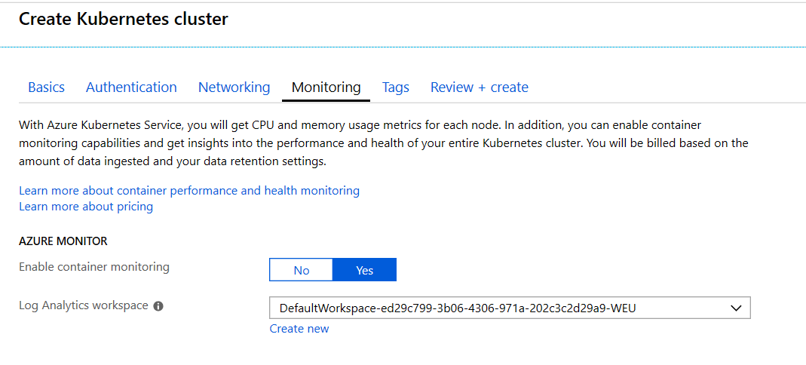
Enable monitoring - Portal
Creating new AKS Cluster
az aks create --resource-group myAKSCluster --name myAKSCluster --node-count 1 --enable-addons monitoring --generate-ssh-keys
Enable monitoring on existing AKS Cluster
az aks enable-addons -a monitoring -n MyExistingManagedCluster -g MyExistingManagedClusterRG
Notes:
When you enable monitoring OMS Agent is deployed as a daemonset for you!! No need to do this manually anymore

Slide 24
Enable monitoring - CLI
Creating new AKS Cluster
az aks create --resource-group myAKSCluster --name myAKSCluster --node-count 1 --enable-addons monitoring --generate-ssh-keys
Enable monitoring on existing AKS Cluster
az aks enable-addons -a monitoring -n MyExistingManagedCluster -g MyExistingManagedClusterRG
Notes:
When you enable monitoring OMS Agent is deployed as a daemonset for you!! No need to do this manually anymore

Slide 25
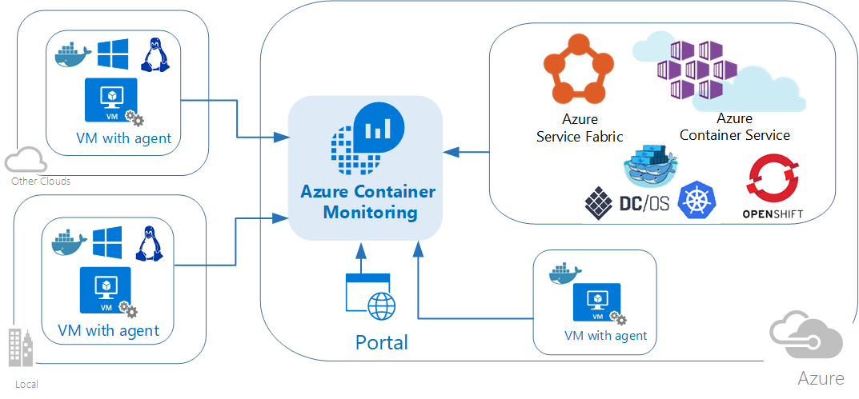
Container Monitoring solution in Azure Monitor
View and manage your Docker and Windows container hosts in a single location
The solution shows which containers are running, what container image they’re running, and where containers are running
Supports:
Docker Swarm
DC/OS
Kubernetes
Service Fabric
Red Hat OpenShift
Notes:
Resources:
https://docs.microsoft.com/en-us/azure/azure-monitor/insights/containers
Details:
You can view detailed audit information showing commands used with containers.
On computers running Windows, you can centralize and compare logs from Windows Server, Hyper-V, and Docker containers
Kubernetes environments hosted on Azure Kubernetes Service (AKS), not supported
AKS should use Azure Monitor for Containers

Slide 26
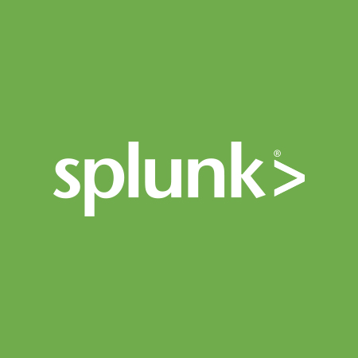



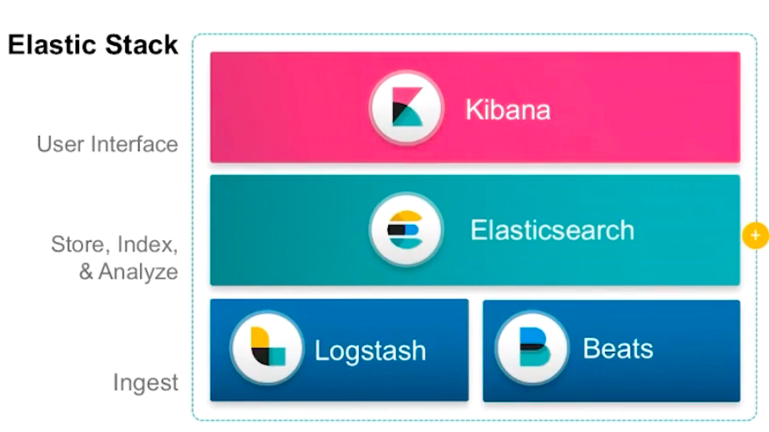





Other monitoring options

Slide 27
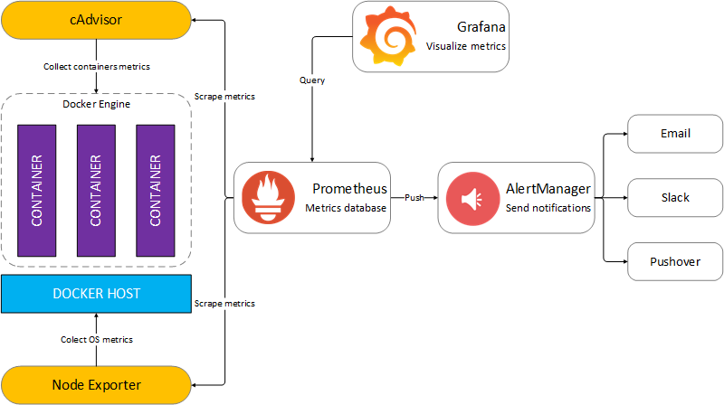
Prometheus + Grafana
Prometheus is an open-source systems monitoring and alerting toolkit
Grafana allows you to query, visualize, alert on and understand your metrics no matter where they are stored.

Slide 28
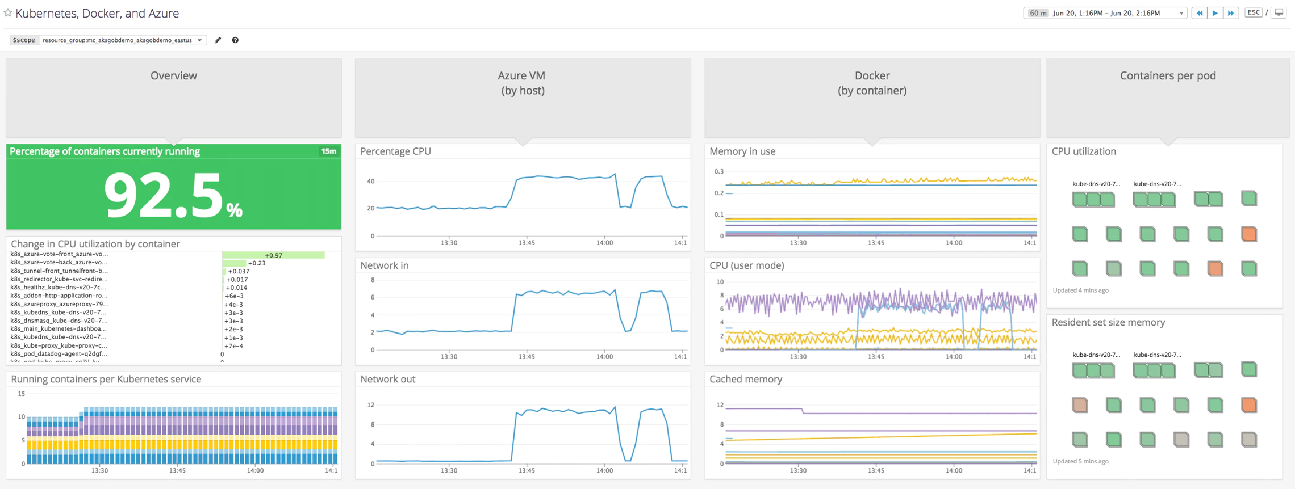
Datadog
Datadog’s integrations with Kubernetes and Azure Monitor provide comprehensive visibility into AKS infrastructure with no additional configuration
To use, you deploy the containerized Datadog Agent as a DaemonSet within your AKS cluster using a provided YAML manifest
https://www.datadoghq.com/blog/announcing-aks/
Notes:
Resources to review:
https://www.datadoghq.com/blog/announcing-aks/
https://www.datadoghq.com/blog/azure-monitoring-enhancements/
Details:
Datadog can help you get full visibility into your AKS deployment by collecting metrics, distributed request traces, and logs from Kubernetes, Azure, and every service running in your container infrastructure
Datadog is introducing a new Live Container view that gives you insight into the status and performance of all your containers in real time

Slide 29
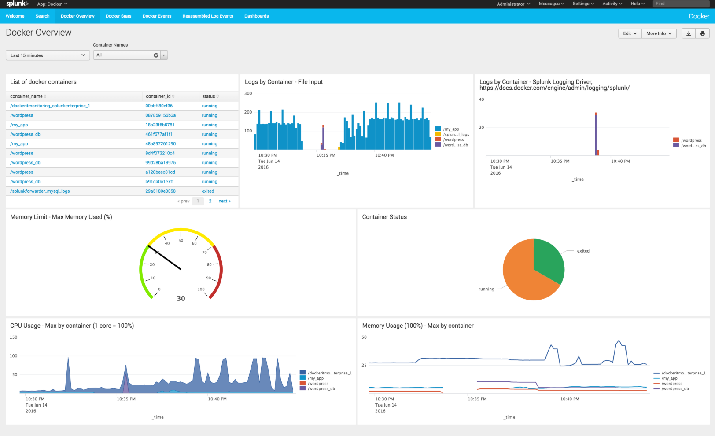
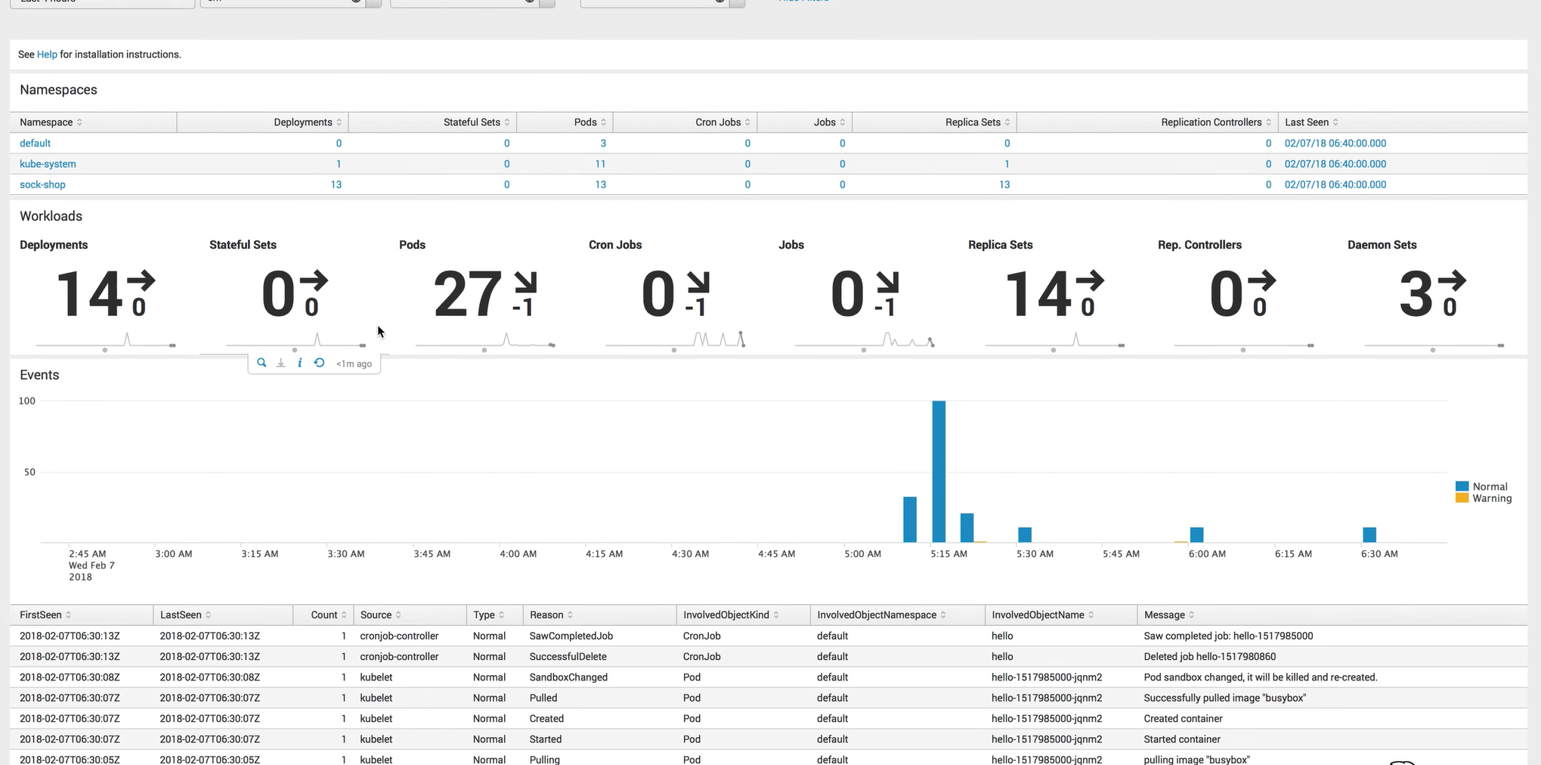
Splunk
Collect, analyze and act upon the untapped value of the big data generated by your technology infrastructure, security systems and business applications giving you the insights to drive operational performance and business results
Notes:
Free and we have a paid enterprise option

Slide 30
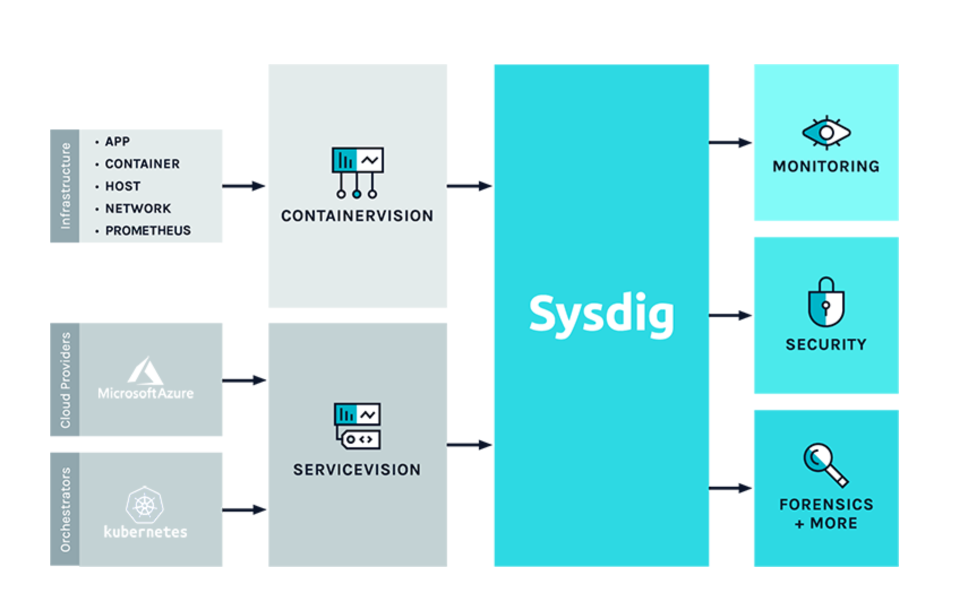
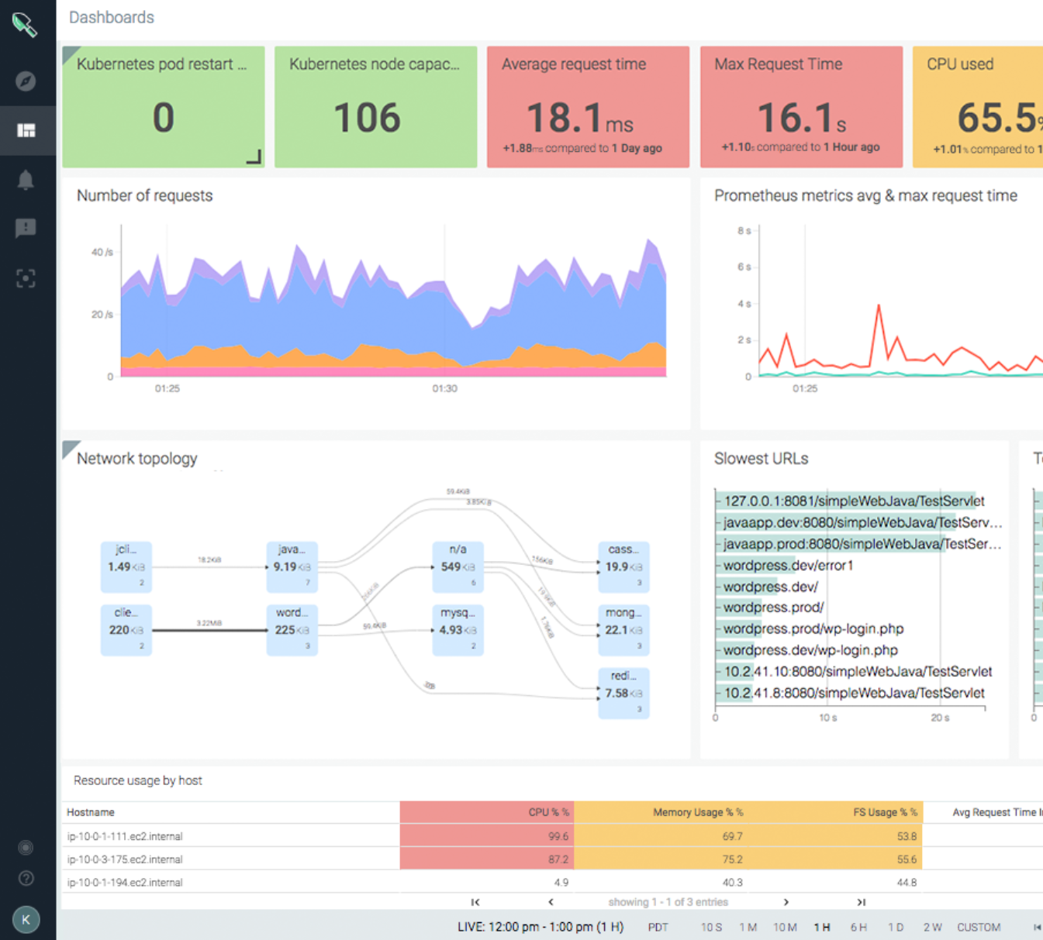
Sysdig
Monitoring and troubleshooting service provides dashboard based on various metrics like CPU, Memory, Network etc.
Service-level visibility provided by leveraging metadata from AKS
https://sysdig.com/partners/microsoft-azure/
Notes:
Resources:
https://sysdig.com/partners/microsoft-azure/
https://sysdig.com/blog/scanning-images-in-azure-container-registry/
https://sysdig.com/press-releases/sysdig-monitor-3-0-prometheus-kubernetes-docker/
https://containerjournal.com/2018/10/03/sysdig-embraces-prometheus-for-container-monitoring/
Sysdig delivers unparalleled Prometheus monitoring and troubleshooting in large Kubernetes, cloud and container environments
Docker monitoring, alerting + troubleshooting with intelligent Kubernetes, Mesos and Swarm integration.

